Slide 1

BANK ANALYTICS

Slide 2
AGENDA
Introduction
Objective
Why Is It Important To Analyze The Data
How Banks Use Data Analytics
Tools Used
Dashboard
KPI 1
KPI 2
SWOT Analysis
Findings
Recommendations
Conclusion

Slide 3
INTRODUCTION
Before we explain what is banking analytics, let’s take a moment to first discuss about data analytics. Data analytics is “the science of analyzing raw data in order to make conclusions about that information.” The raw data in question can be either structured or unstructured and come from either internal or external sources. Now a days data analytics plays an important role not only in banking but also in sectors. To that end, banking analytics simply refers to any application of data analytics in banking.

Slide 4
Objective
The aim of this project is to analyse loan data provided by a financial institution for a diverse group of customers. The analysis will focus on customers with varied grades and sub-grade levels, taking into consideration various factors such as loan disbursement reasons, funded amount, revolving balance values, payment modes, and last payment values across different states and geolocations.

Slide 5
Why Is It Important To Analyze The Data
Understand your audience and customers better
Risk assessment and mitigation
Determine interest rates and forecasting
Manage overall funds situation
Maximize sales while minimizing cost by optimizing revenue
Improve customer satisfaction and loyalty
Improved marketing and remarketing campaign planning

Slide 6
How Banks Use Data Analytics
Risk Supply Demand
Fraud detection
Risk modelling for investment banks
Credit risk analysis
Sales performance analysis
Branch and online channel sales analysis
AI-driven chatbots & Virtual Assistants
Personalized marketing
Lifetime value prediction

Slide 7




Tools Used

Slide 8
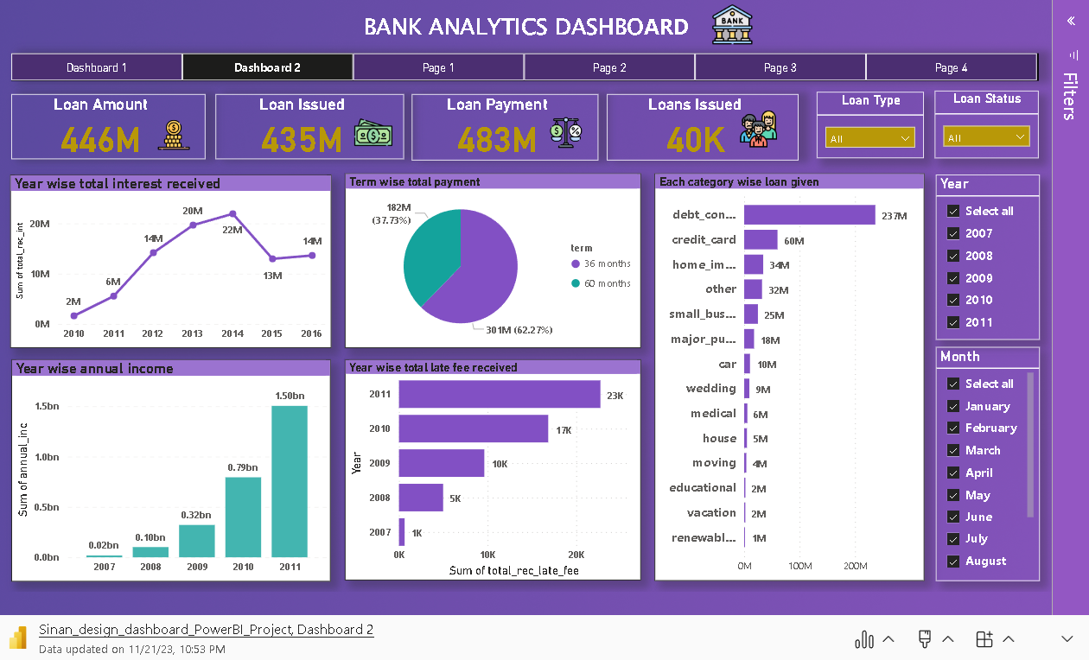

Slide 9
01
02
03
Yearly Loan Funding Trends
Customer Housing and Payment Trends
Payment Verification Disparity
Seasonal Trend Identification
Performance Benchmarking
Strategic Resource Allocation
Risk Assessment
Fraud Detection
Risk Assessment
Revenue Analysis
Tailored Customer Engagement
Customized Risk Mitigation Strategies
Payment Processing Optimization
04
05
06
Grade and Sub-Grade wise revolving balance
Annual Income of Customers
Category-wise Loan Amount Issued
Detailed Portfolio Segmentation
Risk Stratification
Informed Product Innovation
Profitability Analysis
Creditworthiness Assessment
Income Segmentation Analysis
Market Expansion Opportunities
Efficient Collection Strategies
Market Demand Assessment
Cost-Benefit Analysis
Regulatory Compliance
Risk Management

Slide 10
07
08
09
Annual Interest Income
Annual Accumulated Late Charges
Loan Disbursement by Term
Financial Performance Analysis
Trend Analysis
Budgeting and Forecasting
Capital Allocation
Trend Analysis
Seasonal Patterns
Impact on Cash Flow
Customer Communication Impact
Strategic Portfolio Optimization
Responsive Product Offerings
Customer-Centric Strategies
Risk-Informed Decision-Making
10
11
12
Last Credit Update and State-wise Loan Behavior
Loan Repayment Performance
Annual Customer Base
Regional Performance Assessment
Market Expansion Planning
Dynamic Risk Management
Financial Health
Performance Benchmarks
Collection Strategies
Customer Growth Analysis
Marketing and Outreach Effectiveness
Revenue Forecasting
Operational Planning

Slide 11
Strength
Weakness
Opportunity
Threat
Analysis
Strengths
Weakness
Data Accuracy
Avoid data redundancy
Accessibility
Weak relationship between bank and customer
Opportunities
Personalized offers and discounts
Innovations
Threats
Fraudulent activity
Security Concerns

Slide 12

Findings
The data indicates a consistent increase in the sum of loan amounts from 2007 to 2011. This suggests a potential trend of growth.
Across the years, the fourth quarter consistently stands out with the highest sum of loan amounts. This pattern may be indicative of certain economic or financial trends associated with year-end activities.
The sum of total payment for loans that are "Verified" is 329M. This suggests that verified loans, on average, have a higher total payment amount compared to loans that are not verified.
The sum of total payment for loans that are "Not Verified" is 154M. While this is a substantial amount, it is notably lower than the total payments for verified loans.
The "RENT" category has the highest count, indicating that a significant number of individuals in the dataset are renting their homes. This suggests that, among the given home ownership categories, renting is the most common arrangement among the individuals in the dataset.
The second most common home ownership status is "MORTGAGE" with a count of 17,659. This indicates that a substantial number of individuals in the dataset have opted for homeownership through mortgage financing. Mortgage holders are the second-largest group, highlighting the prevalence of property ownership through mortgage arrangements.

Slide 13

Recommendations
Strategic Resource Allocation.
Promotional Campaigns and Product Offerings.
Targeted Marketing for Verified Loans.
Risk Management for Not Verified Loans.
Tailored Marketing for Rental Properties.
Mortgage-focused Financial Products.
Regional Marketing Strategies.
Risk Management and Compliance.
Risk-Based Pricing.
Customized Product Features.

Slide 14
Conclusion
To summarize, Analytics provides banks with more marketing muscle. Functional areas like Risk, Compliance, Fraud, NPA monitoring, and Calculating Value at Risk can benefit greatly from Analytics to ensure optimal performance, and in order to take crucial decisions where timing is very important. It will not be an exaggeration to say that the day-to-day functionalities in a banking environment will be severely limited and handicapped if analytic tools were not made available to them. The use of Analytics can help banks differentiate themselves and remain competitive in the future.

Slide 15


